Slide 1
Agenda (Accounting & CRM Workshop)
Time | Description
8.30 am – 9.00 am | Registration
9.05 am – 9.30 am | Introduction
9.30 am – 11.00 am | Accounting Workshop
11.00 am – 11.15 am | Break
11.15 am – 12.30 pm | CRM Workshop
12.30 pm – 12.40 pm | Q&A
12.40 pm – 12.50 pm | Sales presentation and submission of sign up form
12.50 pm – 1.00 pm | Networking

Slide 2


Slide 3


Authentic Venture Sdn Bhd
vision is to provide sme's with a CLOUD and mobile technology system that can be ACCESS FROM ANYWHERE VIA MULTI DEVICES AND MULTI USERS ENVIRONMENT.
THE LEADING CLOUD-BASED INTEGRATED ENTERPRISE MANAGEMENT SYSTEM SPECIALLY DESIGNED FOR SMES.

Slide 4
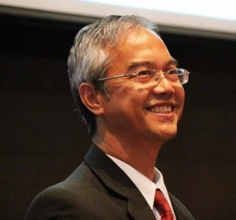
Authentic Venture Sdn Bhd
FOUNDER
The CEO is Hj.Ir. Aziz Ismail, aged 55 years old and with strong experience in enterprise management and industrial automation technology. He is involved in a full range of enterprise management applications and industrial automation technology in his more than 30 years working experience. It include Research and Development of Industrial Automation Products, Enterprise Management Applications , SME solutions, Asset Management solutions and PC management and monitoring applications.

Slide 5









Authentic Venture Sdn Bhd
CLIENTS
Over 1000 SMEs
More than 6000 Users

Slide 6

Authentic Venture Sdn Bhd
INTERNATIONAL BRANCH
INDONESIA
PT Solusi Awani Asia
INDIA (COMING SOON)

Slide 7










Authentic Venture Sdn Bhd
AWARDS
Authentic Venture Sdn Bhd is the leader in software development focusing on cloud-based solutions for companies and organizations to grow their business
Authentic Venture has won multiple awards

